Slide 1
The effects of Impeller Size and Speed on Fluid Mixing
Experiment 10 – team ten
Bo Bramer, Clark Wey, Jose Leal, Angel Rodriquez

Slide 2
Topics Covered
Introduction (background, ethics, objectives)
Materials and Methods
Theory
Results
Discussion
Conclusion

Slide 3
Introduction – Background
Common in industrial applications
Oil and gas industry
Food industry
Convert heterogeneous to homogeneous
Single or multiphase
One or many components

Slide 4
Introduction – Background
Difficult process
Every system has different design variables
No “one-size-fits-all” mixing system
Important to know how any variable affects the mixing process

Slide 5
Introduction – Ethics
Important to have thorough mixing
Increased cost, increased time
When not mixed thoroughly, problems arise
Endanger both environment and process
AIChE code of ethics
“hold paramount the safety, health and welfare of the public and protect the environment in performance of their professional duties”

Slide 6
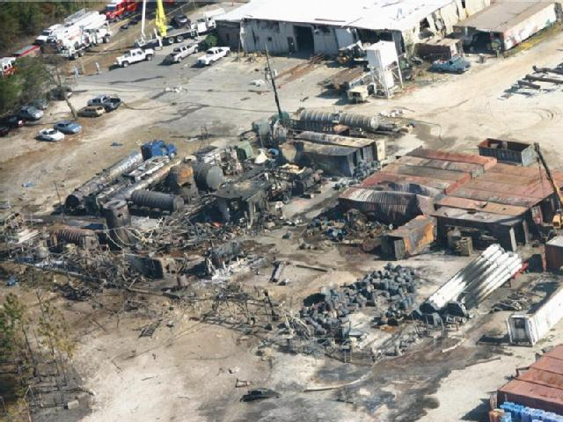
Introduction – Ethics
Thermal Runaway
Catastrophic effect on environment and process
Destroying environment
Low product yield
Dec 19th, 2007
T2 Laboratories in Florida
4 deaths, 32 injuries

Slide 7
Introduction – Objectives
Know how different variables affect mixing process
Density, components, mixing speed, etc.
Characterize mixing in acrylic tank of water with different variables
Blade size, mixing speed, presence of baffles

Slide 8
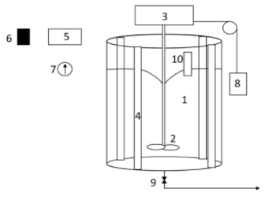
Materials and Methods
Different sized impeller blades
2.1x6.2, 4.3x6.2, 6.5x6.2 cm
Different widths, same lengths
Different impeller speeds
150, 250, 350 RPM
Conductivity probe to determine mixing time
Force meter to determine torque on motor

Slide 9
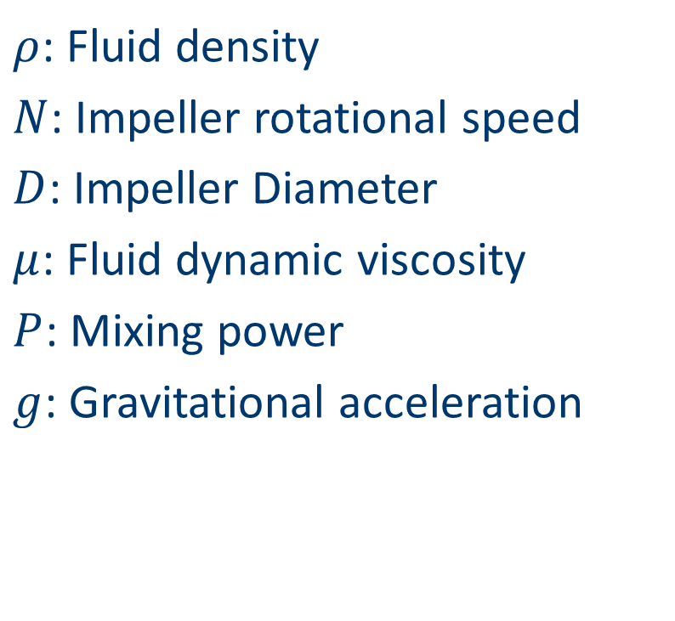
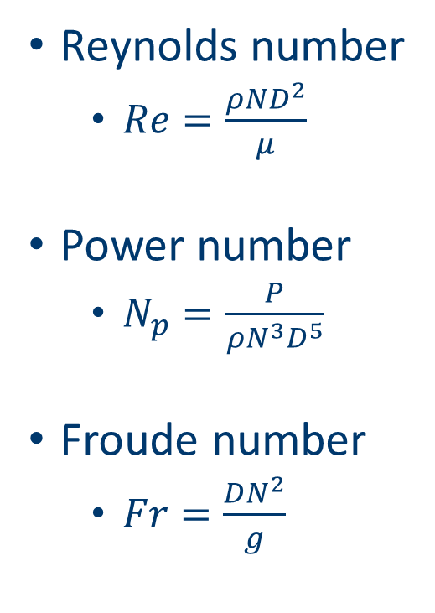
Theory
Reynolds number
$Re=\frac{ρND^{2}}{μ}$
Power number
$N_{p}=\frac{P}{ρN^{3}D^{5}}$
Froude number
$Fr=\frac{DN^{2}}{g}$
$ρ$: Fluid density
$N$: Impeller rotational speed
$D$: Impeller Diameter
$μ$: Fluid dynamic viscosity
$P$: Mixing power
$g$: Gravitational acceleration

Slide 10


Theory
Blending time number
$N_{b}=t_{b}⋅N$
$t_{b}$: blending time

Slide 11
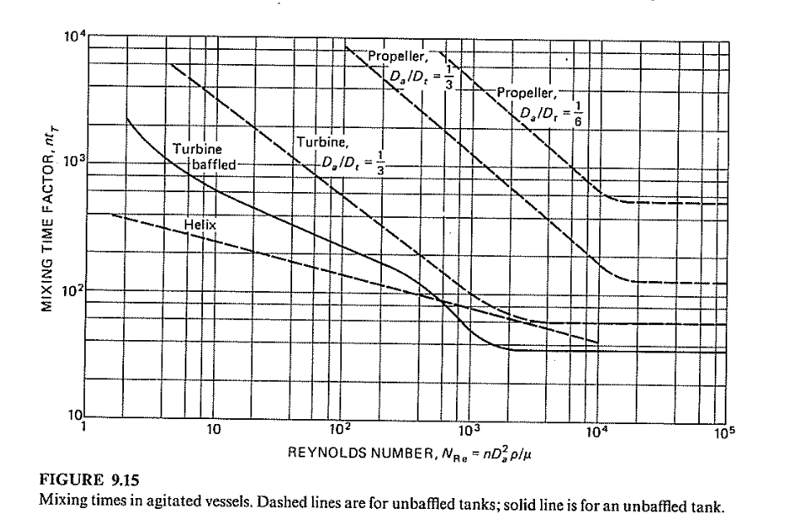
Theory
Expected Reynolds number vs. mixing time number plots

Slide 12
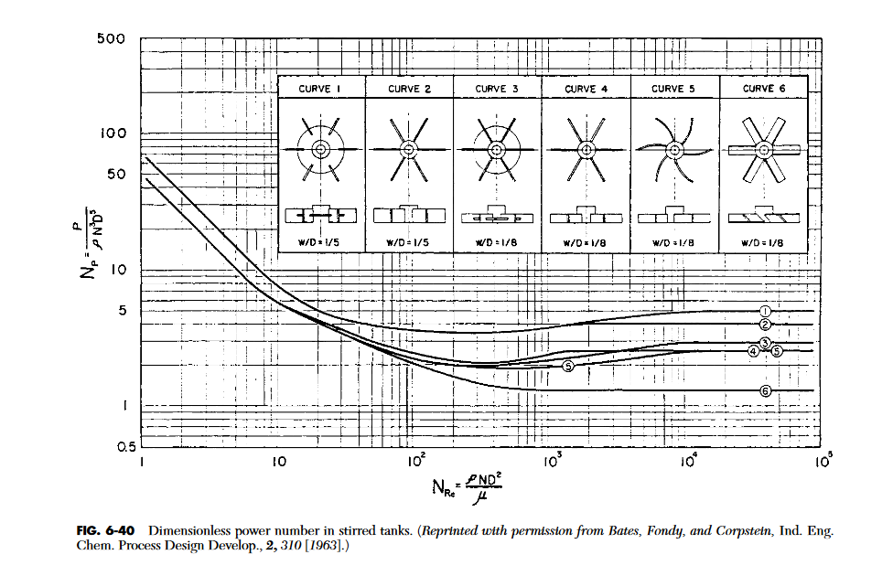
Theory
Expected Reynolds number vs. power number plot

Slide 13
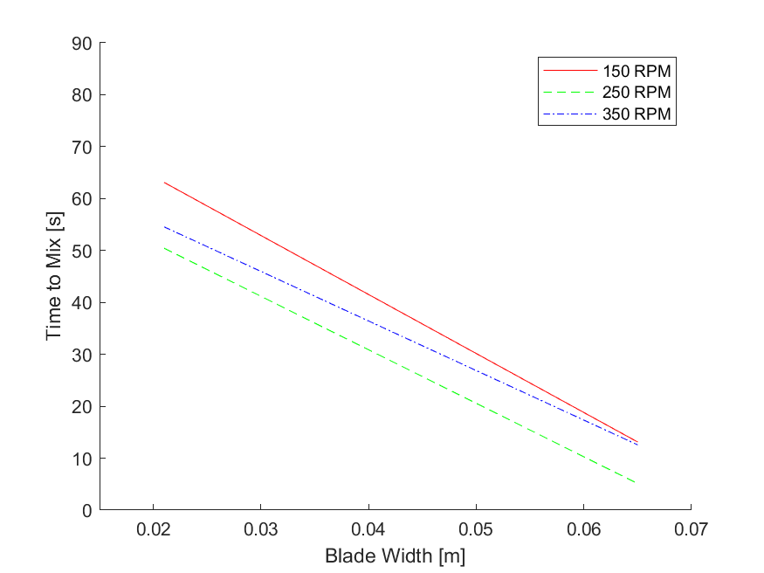
Results
Blade width vs. time to mix while holding rotation speed constant shows negative correlation

Slide 14
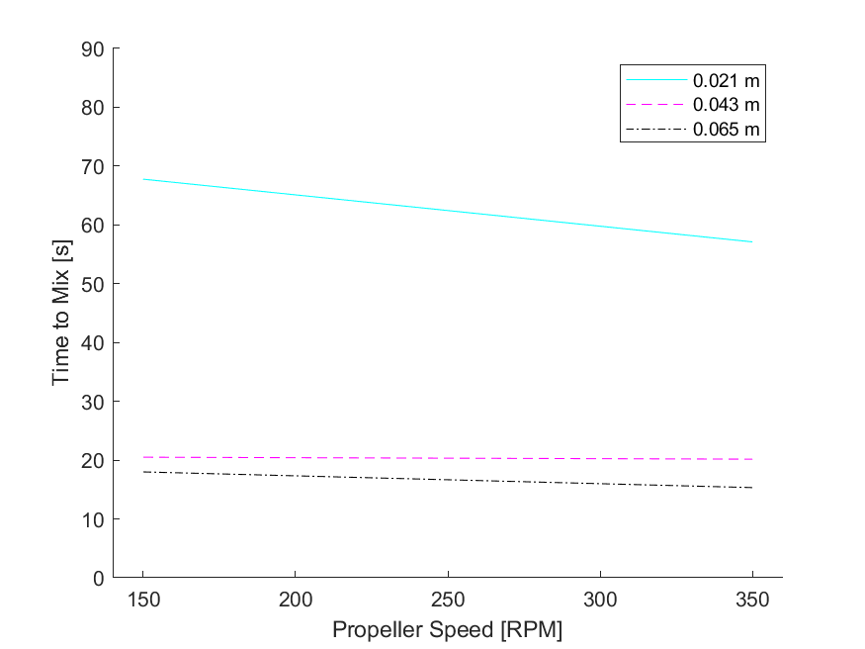
Results
Rotation speed vs. time to mix while holding blade width constant shows no significant correlation

Slide 15
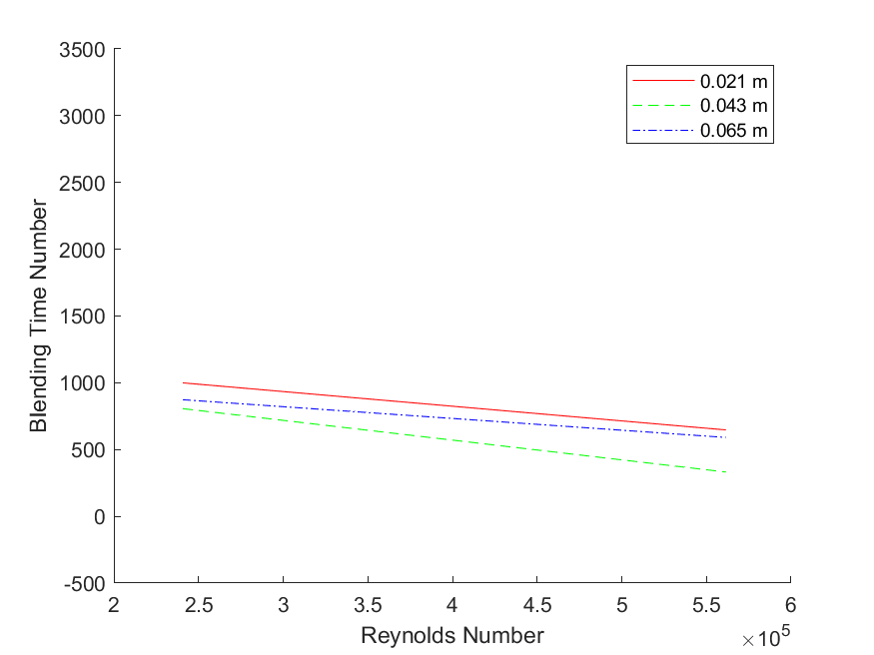
Results
Reynolds number vs. blending time number shows weakly negative correlation

Slide 16
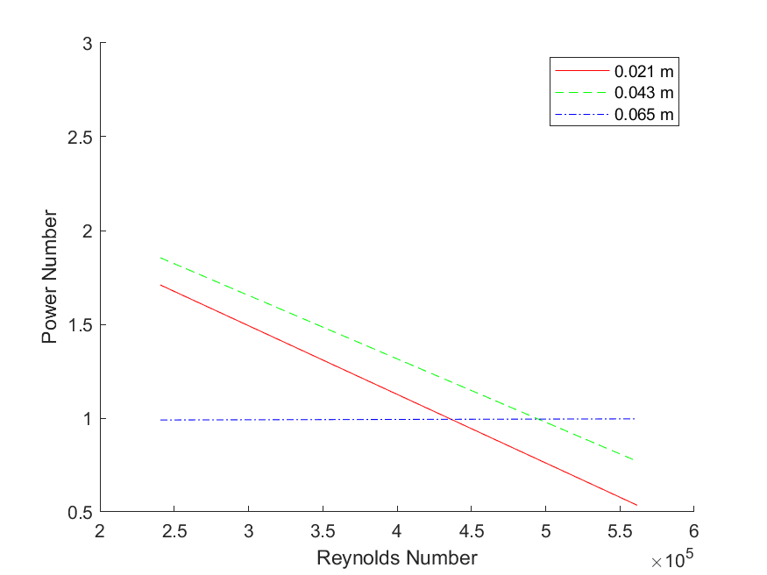
Results
Reynolds number vs. power number shows that over increasing Reynolds number, increase in blade width to blade length ratio led to decrease in power number

Slide 17
Discussion
Increasing blade width decreased time to mix
Increasing blade speed did not decrease time to mix
Increasing Reynolds number had a weakly negative correlation with blending time number
Increasing Reynolds number led to a decrease in power number

Slide 18
Discussion
Reynolds number vs. blending time number

Slide 19
Discussion
Reynolds number vs. power number

Slide 20
Conclusion
Increasing blade widths significantly decreased mixing time
Increasing impeller speeds did not
Higher Reynolds numbers lead to better performance
Mixing time number, power number

Slide 21
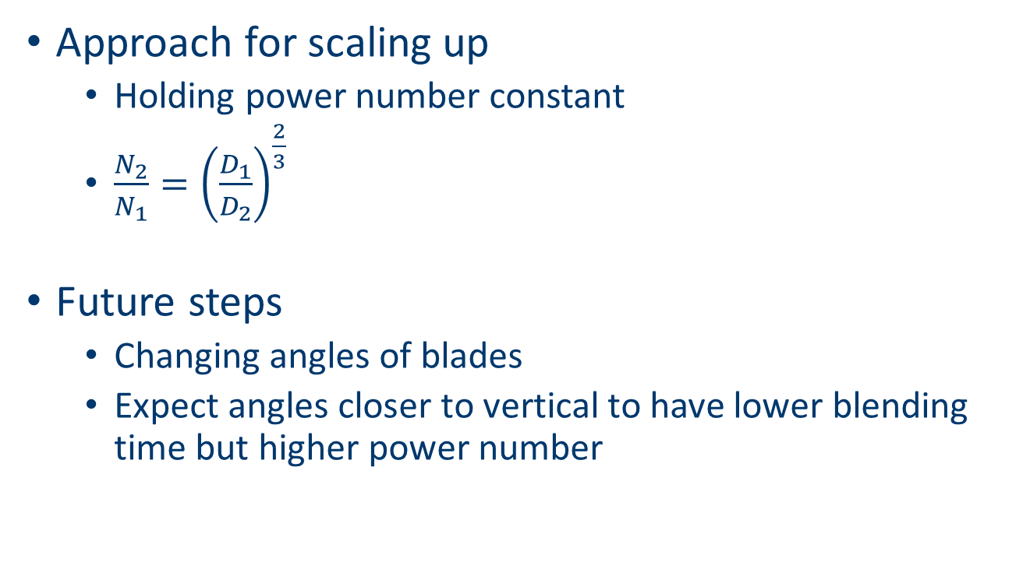
Conclusion
Approach for scaling up
Holding power number constant
$\frac{N_{2}}{N_{1}}={\left(\frac{D_{1}}{D_{2}}\right)}^{\frac{2}{3}}$
Future steps
Changing angles of blades
Expect angles closer to vertical to have lower blending time but higher power number

Slide 22
Citations
J. B. McClintock, R. A. Angus, M. R. Mcdonald, C. D. Amsler, S. A. Catledge, and Y. K. Vohra, ``Rapid dissolution of shells of weakly calcified Antarctic Benthic macroorganisms indicates high vulnerability to ocean acidification: Antarctic Science,'' Cambridge Core, 01-Oct-2009. [Online]. Available: https://www.cambridge.org/core/journals/antarctic-science/article/abs/rapid-dissolution-of-shells-of-weakly-calcified-antarctic-benthic-macroorganisms-indicates-high-vulnerability-to-ocean-acidification/DC9B2354DAACA88BC5305C1D69BB578D. [Accessed: 19-Oct-2021].
“Code of Ethics.” AIChE's, 21 Aug. 2020, https://www.aiche.org/about/governance/policies/code-ethics.
“T2 Laboratories Inc.. Reactive Chemical Explosion.” CSB, https://www.csb.gov/t2-laboratories-inc-reactive-chemical-explosion/.
Kummer, Alex, and Tamás Varga. “What Do We Know Already about Reactor Runaway? - A Review.” Process Safety and Environmental Protection, vol. 147, 2021, pp. 460–476.

